Slide 1
Country food
By:Jiyoung,Jiwon

Slide 2
Introduction
We will present about the many kinds of foods and their kcal.
If we know about the kcals of the foods, we can control what we have to eat or not.
We knew a little about Korean food, and wanted to know about other countries' food's kcal, and the average of them.

Slide 3

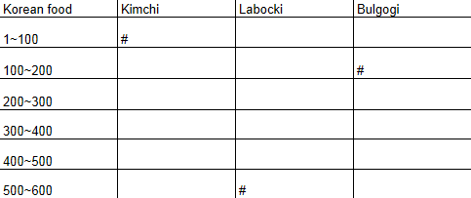
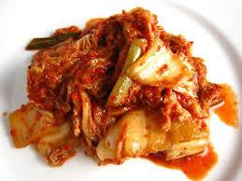
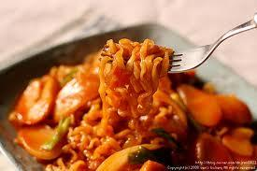
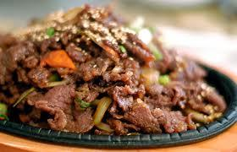
Korean Food kcal
(25 kcal)
(160 kcal)
(570 kcal)

Slide 4

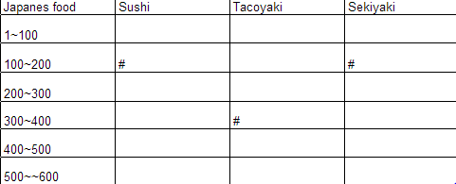
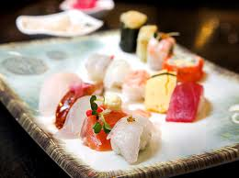
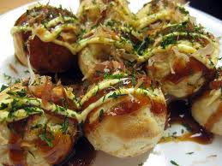
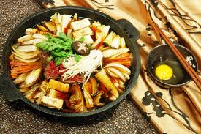
Japanese Food kcal
(100 kcal)
(205 kcal)
(350 kcal)

Slide 5

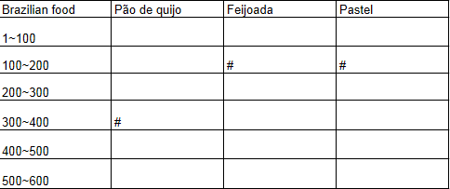
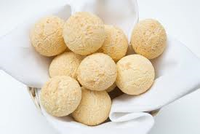
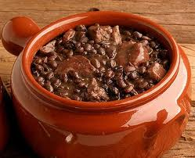
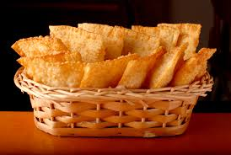
Brazilian food kcal
(168 kcal)
(114 kcal)
(330 kcal)

Slide 6

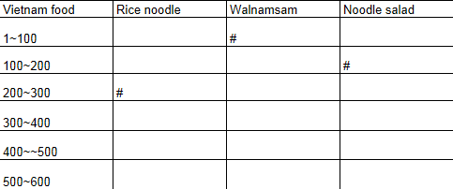
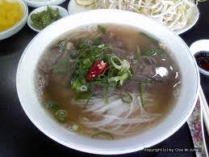
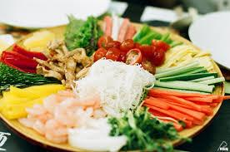
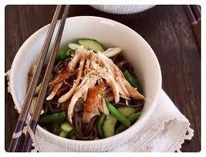
Vietnam food kcal
(840 kcal)
(180 kcal)
(300 kcal)

Slide 7
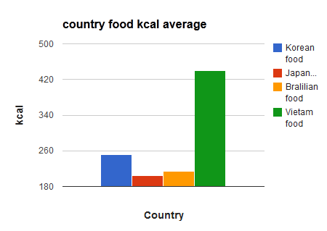
country food kcal average

Slide 8
Conclusion
Did you learned many facts?
When we were working this project.
We thought that we can't eat very much because there are many kcal in foods.
We had new question. Our new question was, how much salt is in each country's food?

Slide 9



THANK YOU!!

